Slide 1

C/C++
Working with Visual Studio

Slide 2
Table of contents Index / Agenda
Working with Visual Studio - Overview
Recommended practices
Creating a project
(More) Recommended practices
Configuring a project
Binaries and paths
Build Configurations
Author

Slide 3
Working with Microsoft Visual Studio - Overview
Using this tutorial you should learn:
How do I create a new project?
What extra (additional) files are created by visual studio for a project?
Some recommendations for name conventions.
How to update the Visual Studio output and temporary directories?
How to select environment variables and project specific variables?
How to run the produced binary from within the IDE?
How to run the produced binary from the outside of the IDE?
Differences involved between the two approaches when working with paths:
Specifying program arguments for the IDE execution.
Updating the working directory for the IDE execution.

Slide 4
Recommended practices
Some recommendations for your assignments:
Choose a location to store all your projects
They are easier to organize in this manner. E.g. D:\code
Name your projects appropriately
Add your name or initials to it. E.g. IonutV_HelloWorld
When all projects (also from your colleagues) are copied to a single machine, they are easier to identify
Provide clean copies of your homework
When submitting your homework by e-mail, don’t send the entire folder, as it contains plenty of “garbage”. Same goes for adding a project to a repository like SVN.
Use lower-case naming for source files (*.c, *.cpp, *.cxx, *.h, *.hpp, *.hxx)
E.g. “hello_world_main.cpp”, “helloworldmain.cpp”

Slide 5
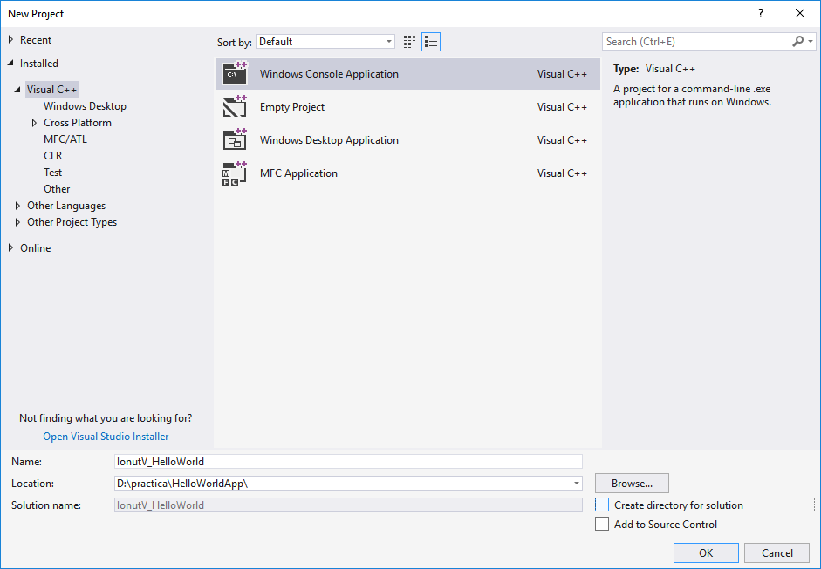
Creating a project
Creating a project. Menu: File → New → Project… (Ctrl + Shift + N)
For simplicity, uncheck
Project name and location

Slide 6
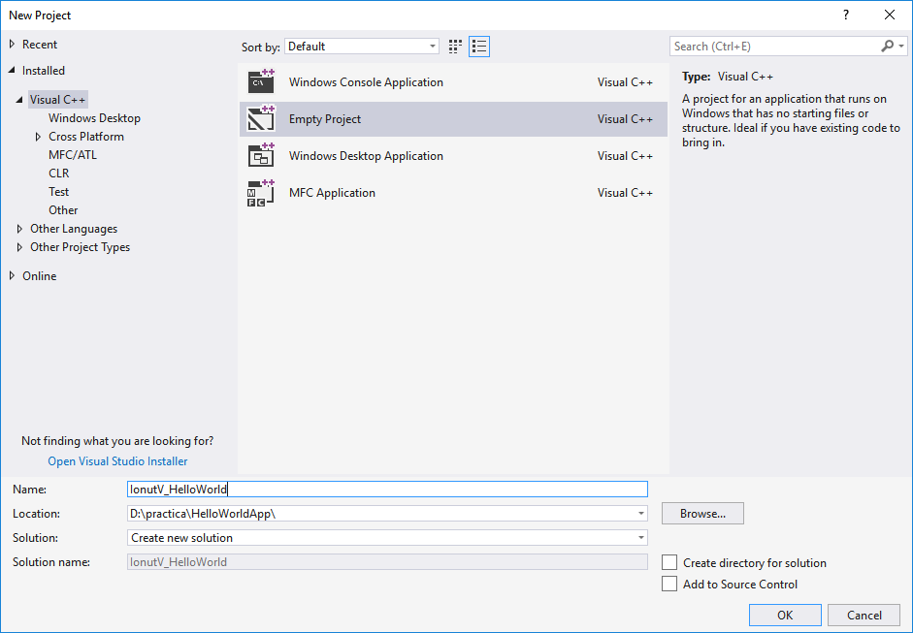
Creating a project
Creating a project. Menu: File → New → Project… (Ctrl + Shift + N)
Most of the time, you want an empty project
Finish

Slide 7
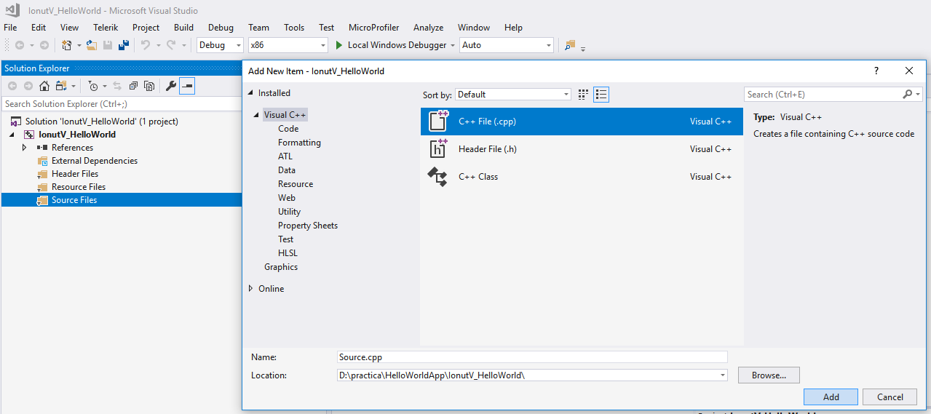
Creating a project – add files
Right click on Source Files or Header Files: Add → New Item… (Ctrl+Shift+A)
Type of file to add
Finish
File name and location

Slide 8
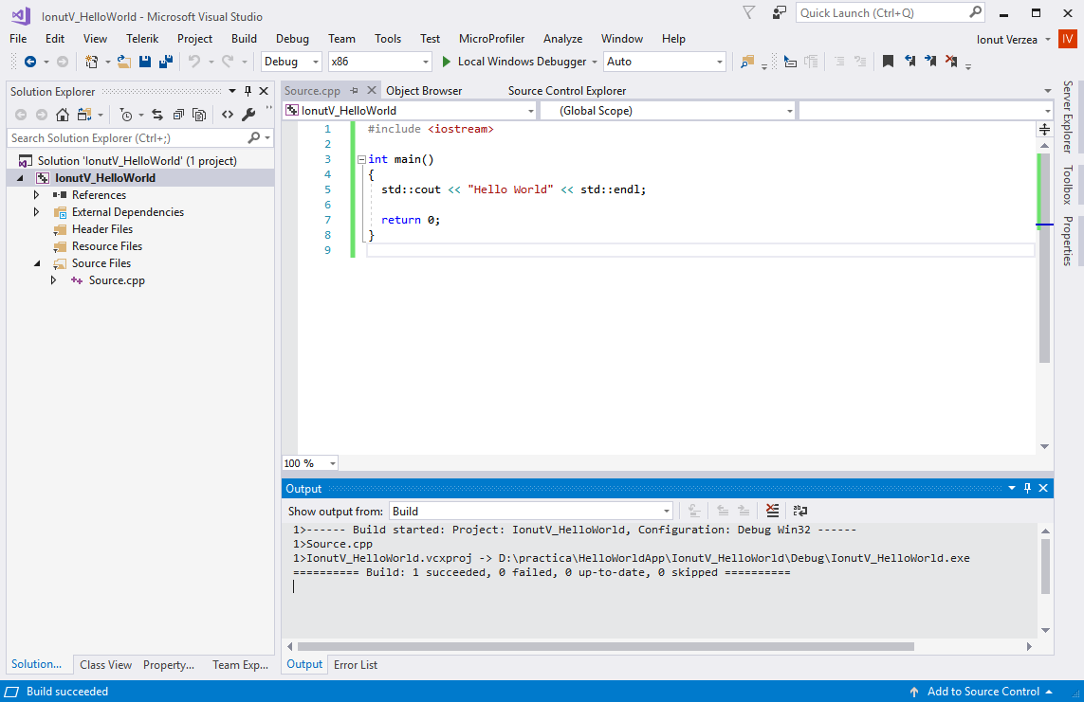
Creating a project – add content in files
The new file
Add your code

Slide 9
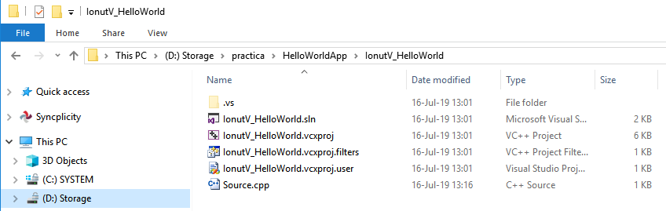
Creating a project – disk content
Content on disk for a new project
Project location
Solution and Project definition
Source code
IDE / Host specific data.
(Do not add to repositories)
(Additional files may be present)

Slide 10
Recommended practices
Recommended practices (continued)
Use separate folders for binary output. E.g. “bin”
This will make it easier to provide deliverables.
Use separate folders for intermediate (temporary) content
E.g. using a “build” intermediate folder allows you to easily clean-up the project by deleting the “build” folder entirely.
Don’t use absolute paths
You might have D:\code\projects\assignment1\input.txt; others might not even have a “D:” drive.
Use relative paths consistently.
Don’t be afraid of longer names (files, variables, etc). But don’t overdo it.
Prefer to declare

Slide 11
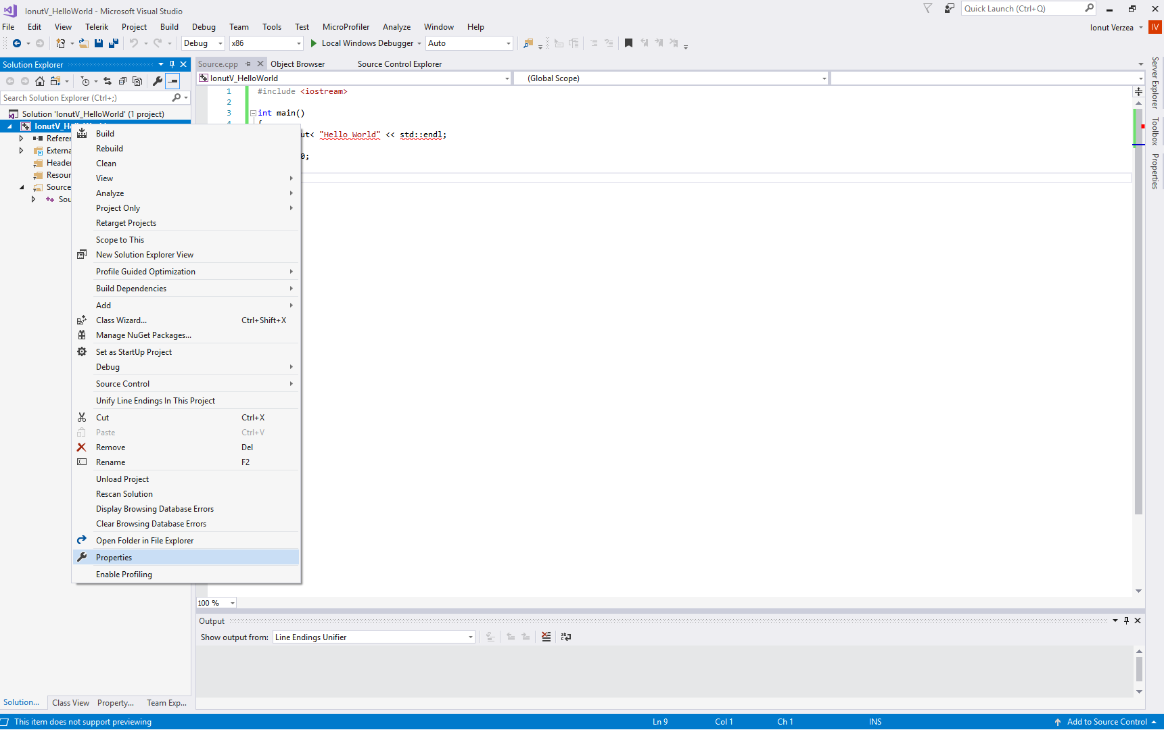
Configuring a project - properties
Right-click the project
Properties

Slide 12
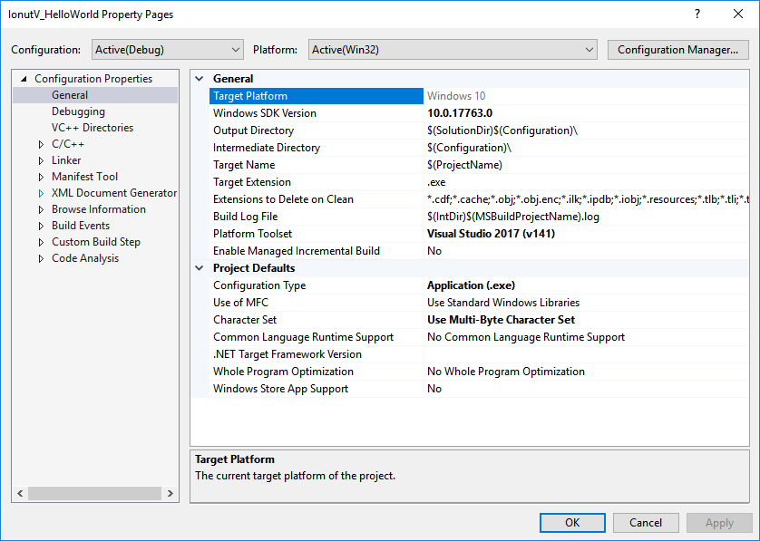
Configuring a project
General settings
Other often used settings

Slide 13
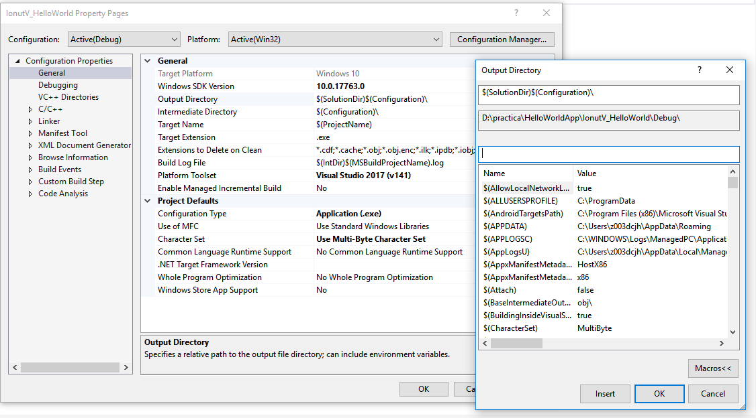
Configuring a project
Where binaries will be stored
Where intermediate objects will be stored
Environment variables (names and values)

Slide 14
Configuring a project
Active configuration
Build the project
Output

Slide 15
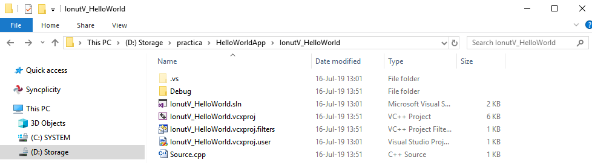
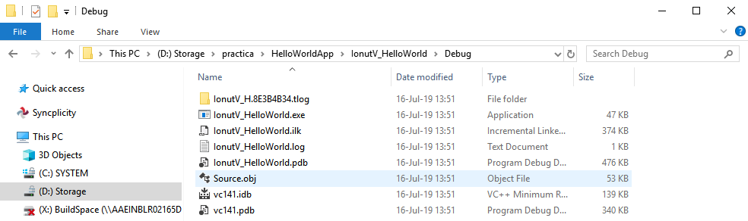
Configuring a project
Content on disk after building the project
new folders and files are created by the IDE:
Project location
Default output and intermediate folders
Generated files and intermediate directories

Slide 16
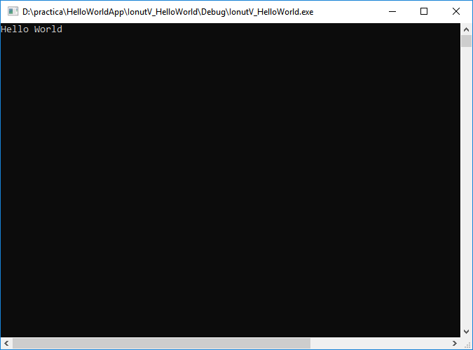
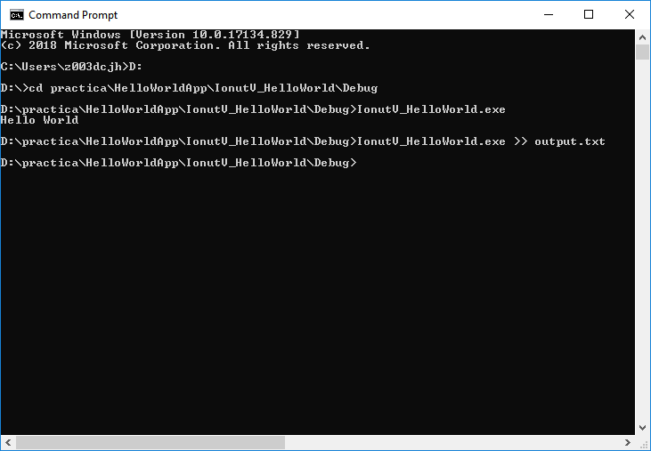
Binaries and paths
Executing the binaries
Directly from the IDE (E.g. via “CTRL” + “F5” keyboard shortcuts)
From the disk (requires the user to open a console manually).
The command line allows redirection arguments to be passed to the application

Slide 17
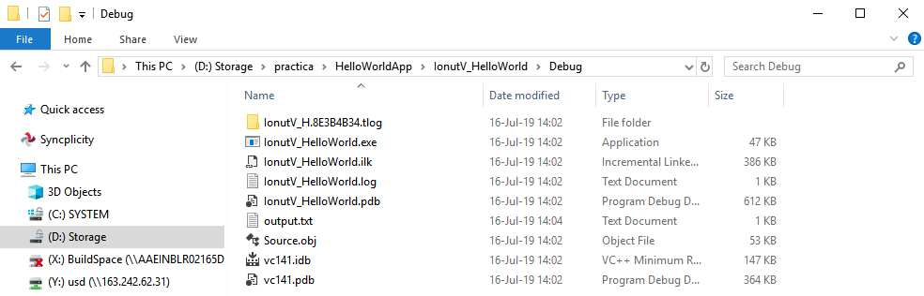
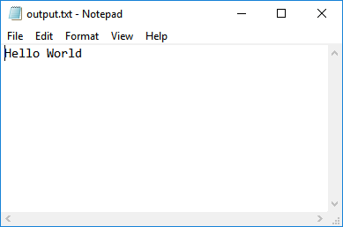
Binaries and paths
Content on disk after running the binary with a redirection of the output
A new text file is created: “output.txt” (in the same directory as the binary)
Binary location
Binary (executed)
Generated output
Same content as the console

Slide 18
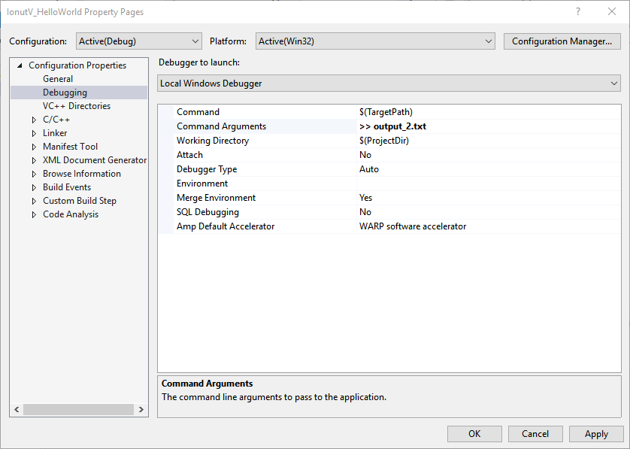
Binaries and paths
Program arguments can also be provided via the IDE and project properties page:
Specify a different value: “output2.txt” (to compare the results)
Configured output and intermediate folders

Slide 19
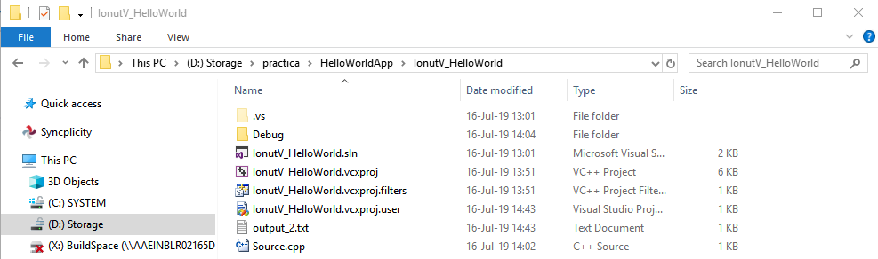
Binaries and paths
Executing the binary from the IDE now redirects the output to the file.
The console no longer prints the “Hello World” message, it redirects it to the text file instead.
Project location
Generated output

Slide 20
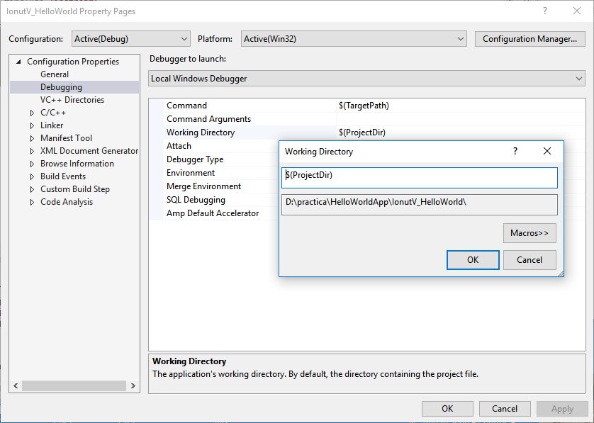
Binaries and paths
A consistent way of working with paths is needed. Otherwise, working with files (E.g. open “input.txt”) would produce different results, based on where the binaries are launched from.
When you launch the binary from the IDE, this is where it starts

Slide 21
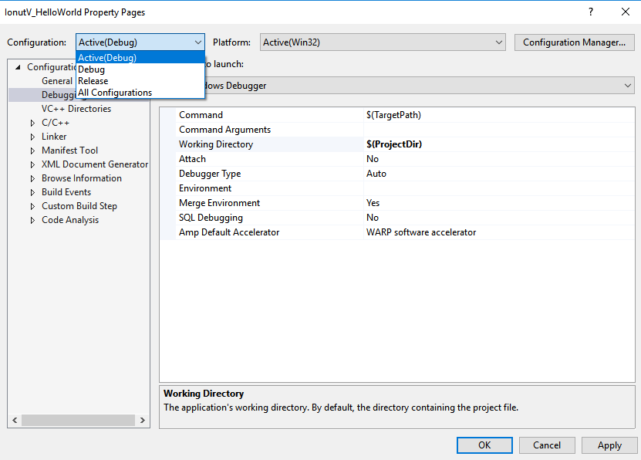
Build Configurations
Debug, Release and other configurations are configured by default separately. If you perform changes in one, it will not impact the others.
It is possible to also edit All, or Multiple configurations.

Slide 22
References
To read/view
https://docs.microsoft.com/en-us/cpp/build/vscpp-step-1-create?view=msvc-170
Video tutorial:
From C++ Tutorial for beginners 3 – Hello world
To C++ Tutorial for beginners 24 – Switch Choosing Between

Slide 23
Contact
Published by Siemens 2023
Ionuț Verzea
Software Engineer ADV D EU RO IFA MI
Blv. 15 Noiembrie Nr.78 500097 Brașov România
E-mail ionut.verzea@siemens.com
Petrescu Vlad Adrian
Software Developer ADV D EU RO ES TLS DI1
Blv. 15 Noiembrie Nr.78 500097 Brașov România
E-mail vlad.petrescu@siemens.com

